Slide 1
CAP776 PROGRAMMING IN PYTHON

Slide 2
OOP concepts:
OOP concepts :
OOP features,
encapsulation,
inheritance,
function overloading,
operator overloading and method overriding,
Exception handling,
catching exceptions,
catching multiple exceptions,
raising exceptions,
custom exception

Slide 3
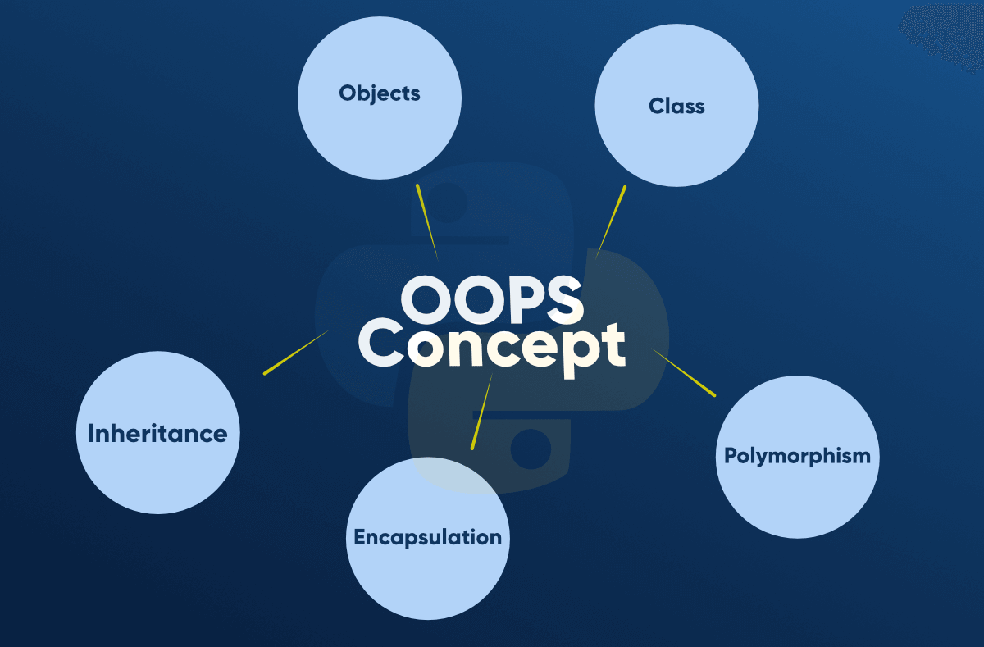

Slide 4

Why class is important?

Slide 5

Class
Class is a collection of similar types of objects.
For example: Fruits is class of mango, apple , orange etc.
Fruits

Slide 6
class in python
A class is a collection of attributes and methods.
Classes are created by keyword class.
Attributes are the variables that belong to a class.
Attributes are always public and can be accessed using the dot (.) operator.
Syntax:
class class_name:
data_members
methods

Slide 7
e.g:
class emp:
id=1234
name=“kumar”
def display(self):
print(“id”,self.id)
print(“name”,self.name)

Slide 8
self
Class methods must have an extra first parameter in the method definition. We do not give a value for this parameter when we call the method, Python provides it
If we have a method that takes no arguments, then we still have to have one argument.
This is similar to this pointer in C++ and this reference in Java.

Slide 9
Create instance :
instance_name=class_name()
e.g:
e=emp()
To call data member and methods:
print(e.id)
print(e.name)
e.disp()

Slide 10


Constructors and Destructors

Slide 11
Constructor in python
By defining _ _ init_ _
Paramerized/non parameterized
Eg:
class classA:
def _ _init_ _(self):
print(“constructor”)
def __init__(self,name,id):
self.id = id;
self.name = name;

Slide 12
Note:
Python does not support the concept of Constructor overloading.
If we try to define the default constructor and the next parameterized constructor within the same class then only the parameterized constructor will remain active but the default constructor will not work.
Solution of Constructor overloading using Default argument

Slide 13
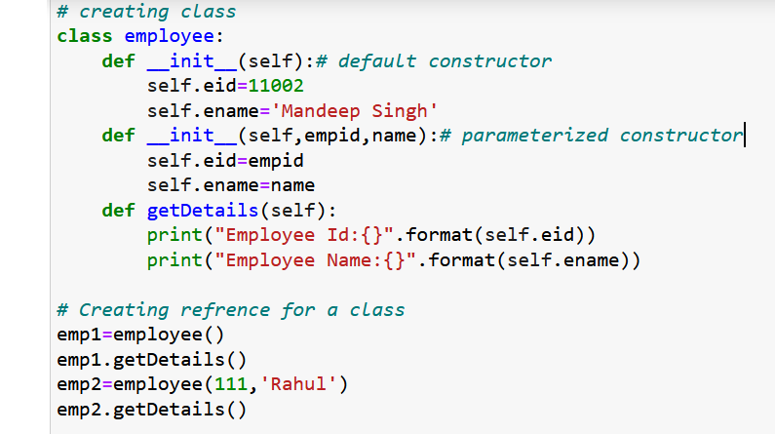
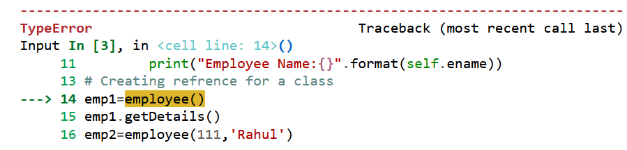
Out put: Error

Slide 14
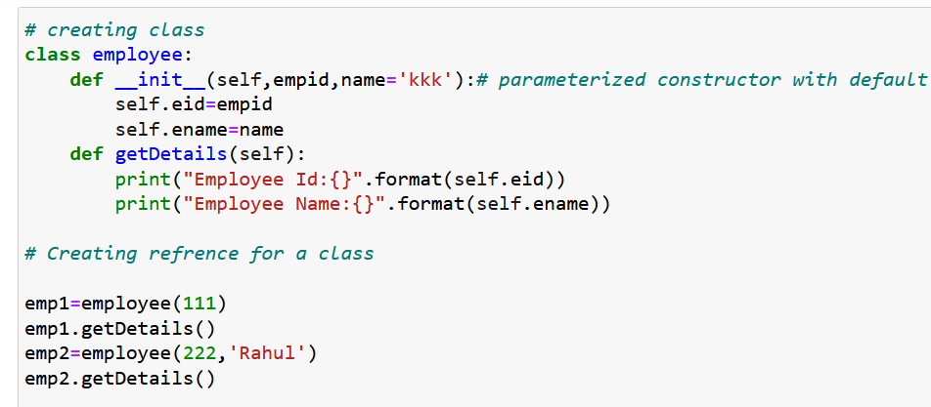
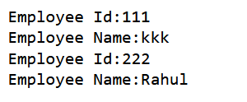

Slide 15
Destructors
Destructors are called when an object gets destroyed. In Python, destructors are not needed as much as in C++ because Python has a garbage collector that handles memory management automatically.
The __del__() method is a known as a destructor method in Python.
It is called when all references to the object have been deleted.

Slide 16
# Python program to illustrate destructor
class Employee:
# Initializing
def __init__(self):
print('Employee created.')
# Deleting (Calling destructor)
def __del__(self):
print('Destructor called, Employee deleted.')
obj = Employee()
del obj

Slide 17
Python built-in class functions
1 | getattr(obj,name,default) | It is used to access the attribute of the object.
2 | setattr(obj, name,value) | It is used to set a particular value to the specific attribute of an object.
3 | delattr(obj, name) | It is used to delete a specific attribute.
4 | hasattr(obj, name) | It returns true if the object contains some specific attribute.

Slide 18
First example of using getattr() and setattr():-
class emp:
id=123
name="dd"
setattr(emp,'id',11)
setattr(emp,'name','today')
print(getattr(emp,'id'))
print(getattr(emp,'name'))

Slide 19
2nd Example of using getattr() and setattr()
class emp:
id=12
name='ss'
obj=emp()
setattr(obj,'id',11)
setattr(obj,'name','today')
print(getattr(emp,'id')) output:-
print(getattr(emp,'name'))
print(obj.id) output:-
print(obj.name)

Slide 20
Access Modifiers
A Class in Python has three types of access modifiers:
Public Access Modifier
Protected Access Modifier
Private Access Modifier

Slide 21
Public
Public Access Modifier:
The members of a class that are declared public are easily accessible from any part of the program. All data members and member functions of a class are public by default.

Slide 22
Example
class Person:
def __init__(self, name, age):
self.name = name # public
self.age = age # public

Slide 23
Protected
Protected Access Modifier:
The members of a class that are declared protected are only accessible to a class derived from it. Data members of a class are declared protected by adding a single underscore ‘_’ symbol before the data member of that class.

Slide 24
Example Protected
class Person:
def __init__(self, name, age,msg):
self._name = name # protected
self._age = age # protected
self.msg = msg # public
p1 = Person("kumar", 20)
print(p1._name) output:-

Slide 25
Private
Private Access Modifier:
The members of a class that are declared private are accessible within the class only, private access modifier is the most secure access modifier.
Data members of a class are declared private by adding a double underscore ‘__’ symbol before the data member of that class.

Slide 26
Private Access modifier example
class Person:
def __init__(self, name, age):
self.__name = name # private
self.__age = age # private
p1 = Person("kumar", 20)
Print(p1.__name) output:-

Slide 27
Accessing private data
class Person:
def __init__(self, name, age):
self.__name = name # private
self.__age = age # private
def output(self):
print(self.__name,self.__age)
p1 = Person("kumar", 20)
p1.output()

Slide 28
class Person:
def __init__(self, name, age, sal):
self.name = name # public
self._age = age # protected
self.__Salary = sal # private
p1 = Person("Rahul", 20, 25000)
print(p1.name) # public: can be accessed
print(p1._age) # protected: can be accessed but not advised
# print(p1.__Salary) # private: will give AttributeError

Slide 29

Encapsulation
we can restrict access to methods and variables. This prevents data from direct modification which is called encapsulation. To achieve this we denote private attributes and define setter method to access this only.

Slide 30
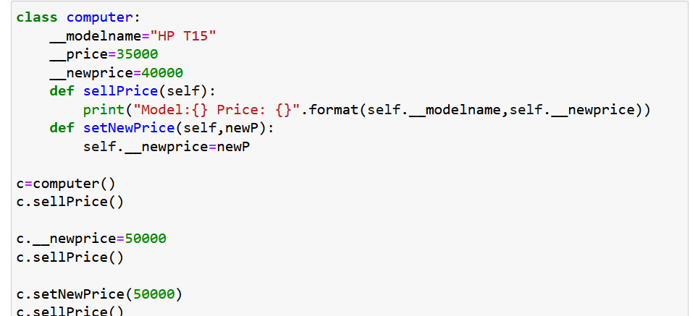
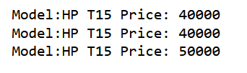

Slide 31



Inheritance: reusability
father
mother
child

Slide 32

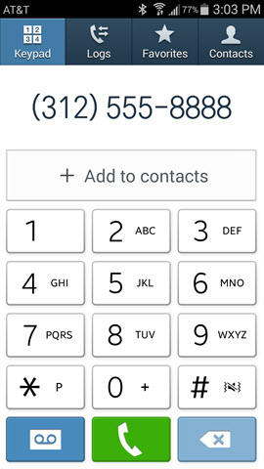

Contact List

Slide 33
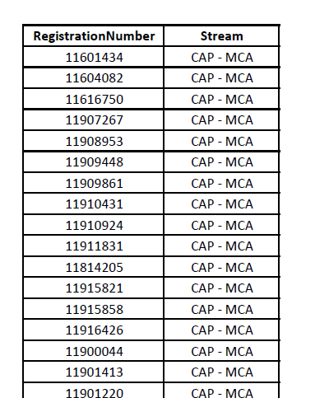
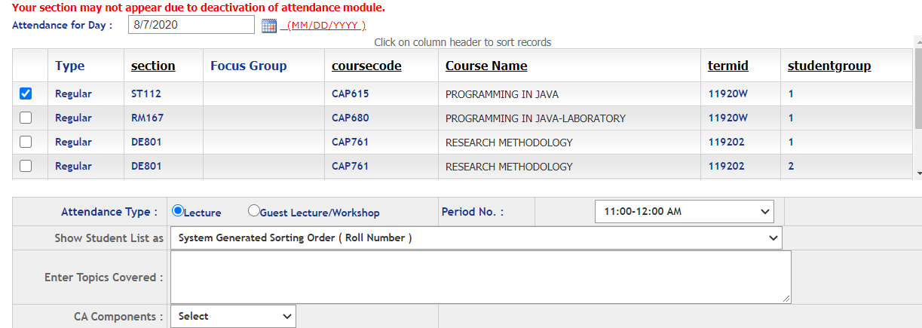
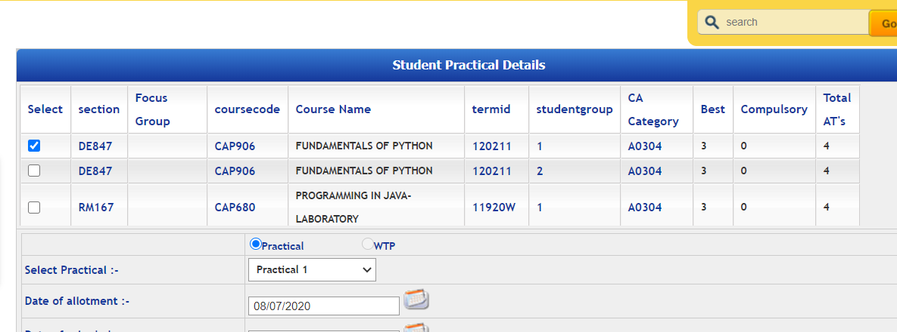
Students
Students in Attendance Module
Same Students in CA Module

Slide 34
Inheritance
Syntax
class BaseClass:
Body of base class
class DerivedClass(BaseClass):
Body of derived class

Slide 35
Inheritance: types of inheritance
One class can hire properties from other class
Advantages: Reusability
A
A
A
B
B
B
C
C
Single
Multilevel
Multiple

Slide 36
A
A
B
C
B
C
Hierarchical Inheritance
D
Hybrid Inheritance

Slide 37
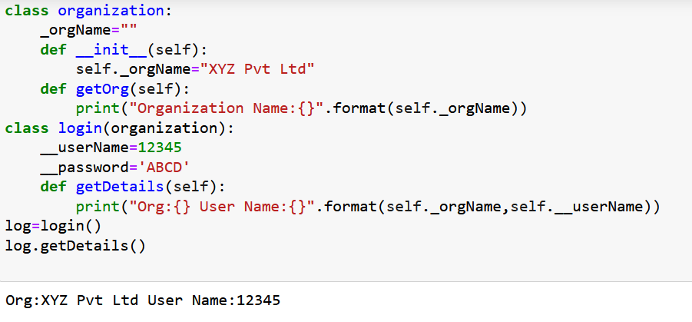
Single inheritance Example

Slide 38
Multilevel inheritance:
One class is going to become base class for other derived class
PMFund
FundAmount=1000
Base Class for class Bank
Bank
BankName=“SBI” IFSCCode=“SBI001”
Derived Class from PMFund and
Base Class for Customer
Customer
Cust_Name, Cust_Id, BalanceAmount
checkBalance():
Derived Class from Bank

Slide 39
Hierarchical inheritance:
One base class and multiple derived class, one –to-many relationship
Bank
rateofInterest
Bank():rateofInterest=0
SBI
Private IFSCCode
Bank():rateofInterest=4.5
PNB
Private IFSCCode
Bank():rateofInterest=5.5

Slide 40
Multiple Inheritance
class Derived(Base1, Base2, ...... BaseN):
class Base1:
class Base2:
.
.
.
class BaseN:
A
B
C

Slide 41



student

Slide 42
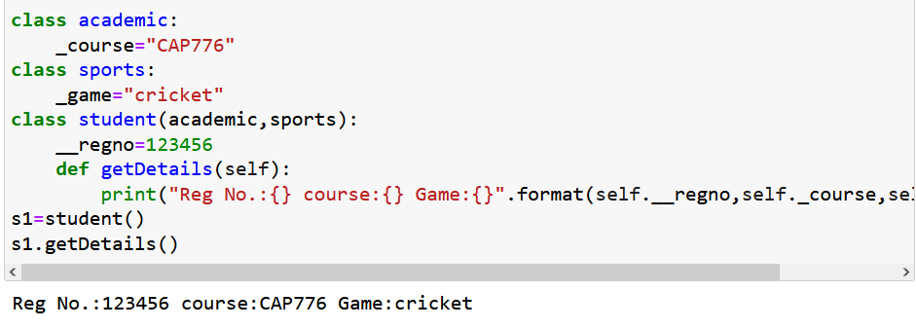

Slide 43
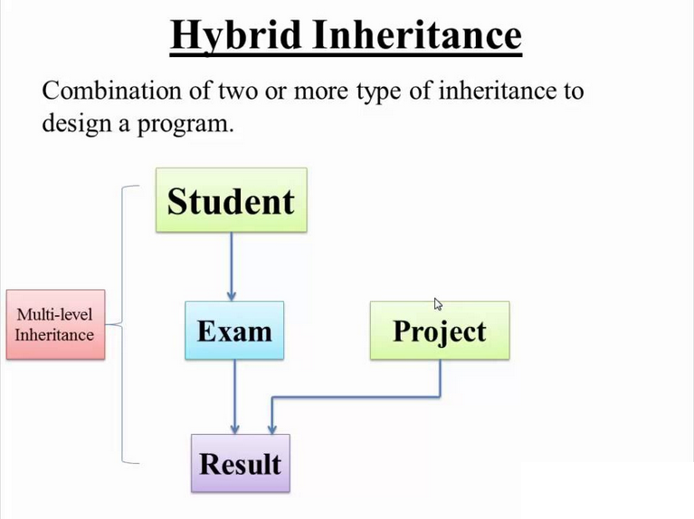

Slide 44
What if both parent classes have a method with the same name?
class P1:
def m1(self):
print("Parent1 Method")
class P2:
def m1(self):
print("Parent2 Method")
class C(P1, P2):
def m2(self):
print("Child Method")
c=C()
c.m2() →output:-
c.m1() →output:-
In the above scenario, which method will child class inherit?

Slide 45
then it depends on the order of inheritance of parent classes in the child class.
class C(P1, P2): ===>P1”s class method will be considered
class C(P2, P1): ===>P2”s class method will be considered

Slide 46
CONSTRUCTORS in INHERITANCE
By default, the super class’s constructor will be available to the subclass.
If child class and super class both have constructors, then?
if you create an object to child class then child class constructor will be executed. While creating object for a class, that class’s constructor is first priority.

Slide 47
Can we call super class constructor from child class constructor?
Yes, we can call super class constructor from child class constructor by using super() function. super() is a predefined function which is useful to call the superclass constructors, variables and methods from the child class.

Slide 48
Example
class A:
def __init__(self):
print("super class A constructor")
class B(A):
def __init__(self):
print("Child class B constructor")
super().__init__()
b=B()

Slide 49



Polymorphism
Person
Father
Teacher
Polymorphism is made from 2 words – ‘poly‘ and ‘morphs.’ The word ‘poly’ means
‘many’ and ‘morphs’ means ‘many forms.’ To put it simply, polymorphism allows us to do the same activity in a variety of ways.

Slide 50







Slide 51
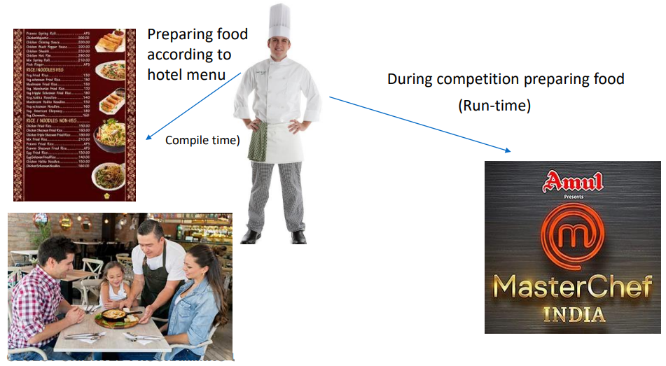
Polymorphism types:

Slide 52
Method overloading in Python
Method overloading can be achieved in python by using one method with different number of arguments.
In other programing languages like java we have more than one method definition for the same method name to achieve it.

Slide 53
Method overloading:-it will consider only last defined method
class collect:
def add(self,a,b):
print(“sum is:” a+b)
def add(self,a,b,c):
print(“sum is:” a + b + c)
obj=collect():
obj.add(1,2,3) output:-
obj.add(1,2)

Slide 54
Method overloading
class cal:
def area(self,x=None,y=None):
if x!=None and y!=None:
return x * y
else:
return x*x
obj=cal()
print(obj.area(2,2)) output:-
print(obj.area(4))

Slide 55
Polymorphism is supported in Python via method overriding and operator overloading. However, Python does not support method overloading.
Note: If we are trying to declare multiple methods with the same name and different number of arguments, then Python will always consider only the method which was last declared.
Overloading
Method overloading
Operator overloading

Slide 56
operator overloading.
If we use the same operator for multiple purposes, then it is nothing but operator overloading.
‘+’- addition operator can be used for Arithmetic addition and String concatenation as well
* multiplication operator can be used for multiplication for numbers and repetition for strings, lists, tuples etc.

Slide 57
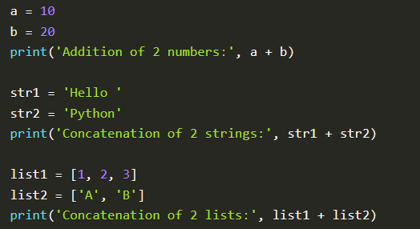
Operator overloading is another type of polymorphism in which the same operator performs various operations depending on the operands. Python allows for operator overloading.
Polymorphism in + operator:

Slide 58
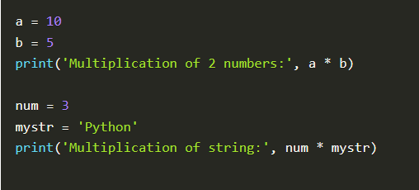
Polymorphism in * operator:

Slide 59
How to Overload the Operators in Python?
Suppose the user has two objects which are the physical representation of a user-defined data type class.
The user has to add two objects using the "+" operator, and it gives an error. This is because the compiler does not know how to add two objects.
So, the user has to define the function for using the operator, and that process is known as "operator overloading".

Slide 60
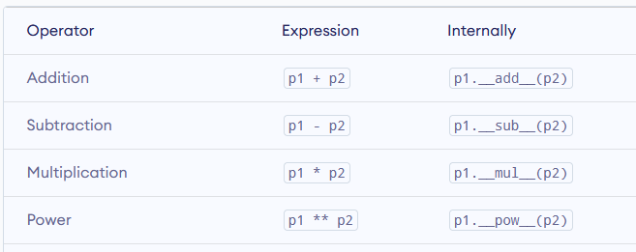
dir(int)

Slide 61
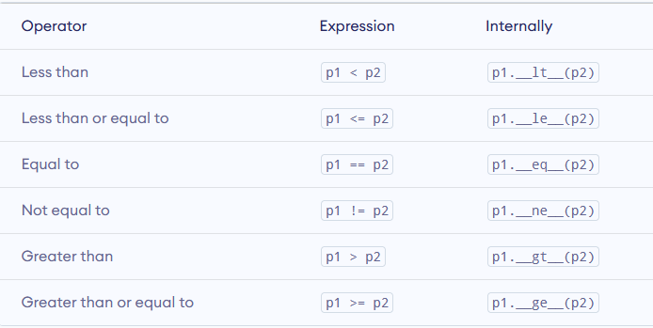

Slide 62
Overload(+)
class PigyBank:
def __init__(self,rupees):
self.rupees=rupees
def __add__(self,rs100):
return self.rupees+rs100.rupees
obj1= PigyBank(100)
obj2= PigyBank(200)
Obj3=obj1 + obj2
print(obj3)

Slide 63
class Student:
def __init__(self, name, marks):
self.name=name
self.marks=marks
s1=Student(“Manu", 100)
s2=Student(“Taran", 200)
print("s1>s2 =", s1>s2)
print("s1<s2 =", s1<s2)
print("s1<=s2 =", s1<=s2)
print("s1>=s2 =", s1>=s2)

Slide 64
class Student:
def __init__(self, name, marks):
self.name=name
self.marks=marks
def __gt__(self, other):
return self.marks>other.marks
def __lt__(self, other):
return self.marks<=other.marks
s1=Student("Manu", 100)
s2=Student("Taran", 200)
print(“value of obj1 is gr then obj2", s1>s2)
print(" value of obj1 is lt obj2 ", s1<s2)

Slide 65
Overload(>)
class A:
def __init__(self,a):
self.a=a
def __gt__(self,b):
if(self.a>b.a):
print("value greater of first obj is gr")
else:
print(" value second obj is greater")
a1=A(10)
b1=A(18)
c1=a1>b1

Slide 66
What will be output?
class A:
def show(self):
pass
class B(A):
def show(self):
print("hello")
b1=B()
b1.show()
A hello
B hellohello
C nothing will display
D Error

Slide 67
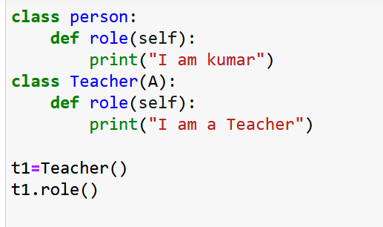
Method overriding
Overriding refers to the process of implementing something again, which already exists in parent class, in child class.
When a method in a subclass has the same name, same parameters or signature and same return type(or sub-type) as a method in its super-class, then the method in the subclass is said to override the method in the super-class.

Slide 68
Abstract Class in Python
An abstract class is a collection of abstract and non-abstract methods.
Abstract methods means A method without definition means without body part.
Non-abstract means A method with definition means with body part.
Abstract class can contain Constructors, Variables, abstract methods, non-abstract methods, and Subclass.
Abstract methods should be implemented in the subclass or child class
if in subclass the implementation of the abstract method is not provided, then that subclass, automatically, will become an abstract class.
Object creation is not possible for abstract class

Slide 69
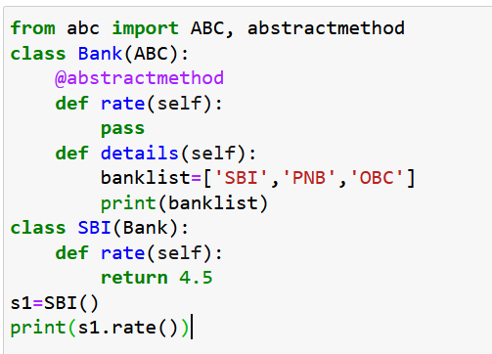
How to declare an abstract method in Python:
Every abstract class in Python should be derived from the ABC class which is present in the abc module.
Abstract methods, in python, are declared by using @abstractmethod decorator.

Slide 70
Exception handling in Python
An exception can be defined as an unusual condition in a program
Python provides a way to handle the exception so that the code can be executed without any interruption.

Slide 71
The problem without handling exceptions
a=int(input("enter a"))
b=int(input("enter b"))
c=a/b
print(c)

Slide 72
Use the try-except statement
try:
#block of code
except Exception1:
#block of code
except Exception2:
#block of code
#other code

Slide 73
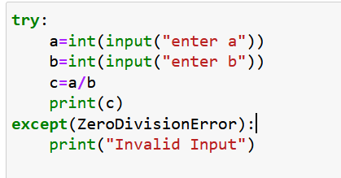
Example:

Slide 74
We can also use the else statement with the try-except statement
try:
#block of code
except Exception1:
#block of code
else:
#this code executes if no except block is executed

Slide 75
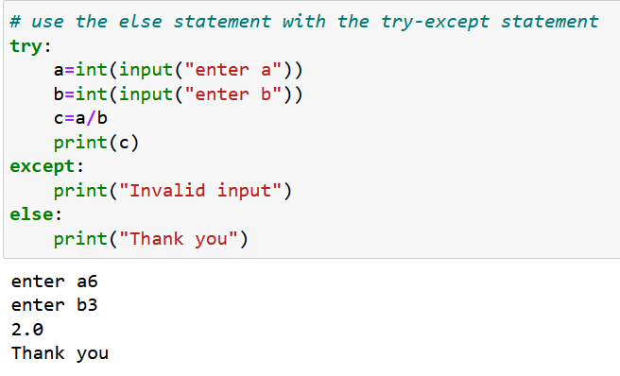

Slide 76
A list of common exceptions:
ZeroDivisionError: Occurs when a number is divided by zero.
NameError: It occurs when a name is not found. It may be local or global.
IndentationError: If incorrect indentation is given.
IOError: It occurs when Input Output operation fails.
EOFError: It occurs when the end of the file is reached, and yet operations are being performed.

Slide 77
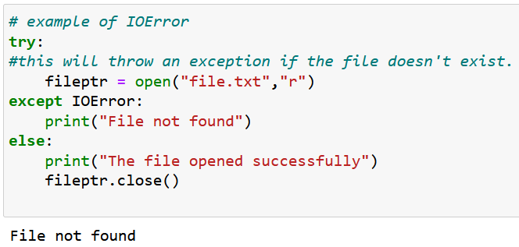
IOError

Slide 78
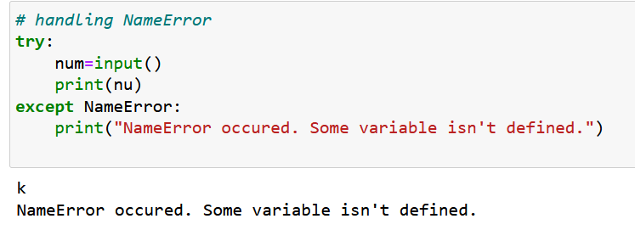
NameError

Slide 79
try...finally block
try:
# block of code
# this may throw an exception
finally:
# block of code
# this will always be executed

Slide 80
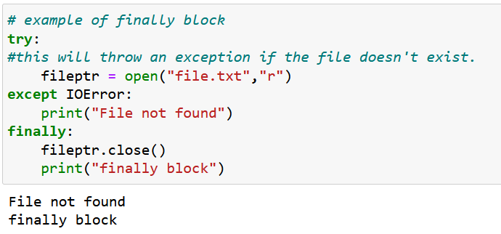

Slide 81
Declaring Multiple Exceptions
try:
#block of code
except (<Exception 1>,<Exception 2>,<Exception 3>,...<Exception n>)
#block of code
else:
#block of code

Slide 82
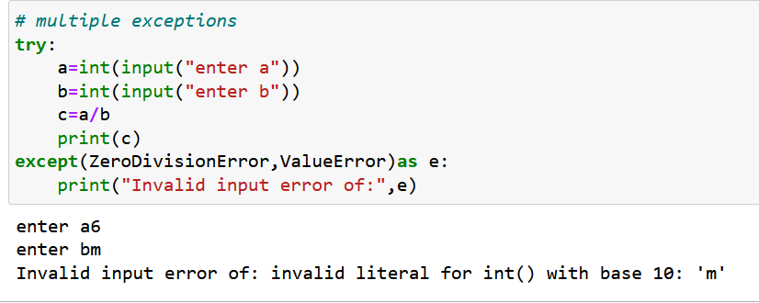

Slide 83
To throw (or raise) an exception, use the raise keyword.
Syntax
raise Exception_class,<value>

Slide 84
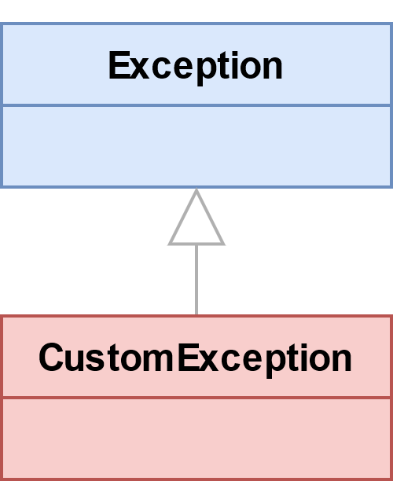
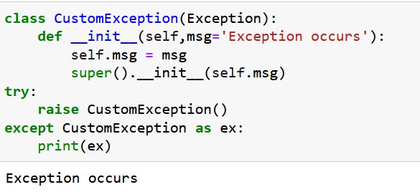
custom exception
users can define custom exceptions by creating a new class. This exception class has to be derived from the built-in Exception class.

Slide 85
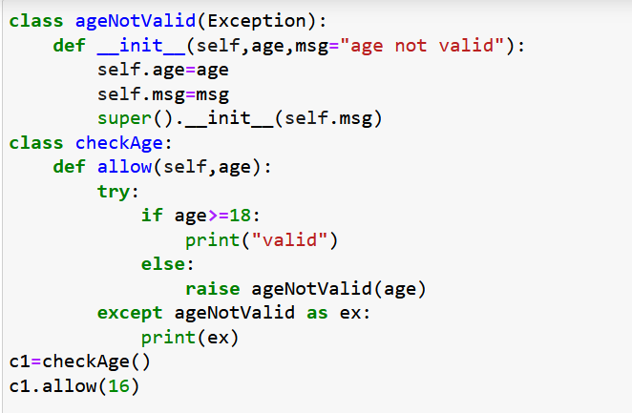
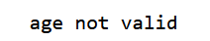

Slide 86
Thanks

